Slide 1
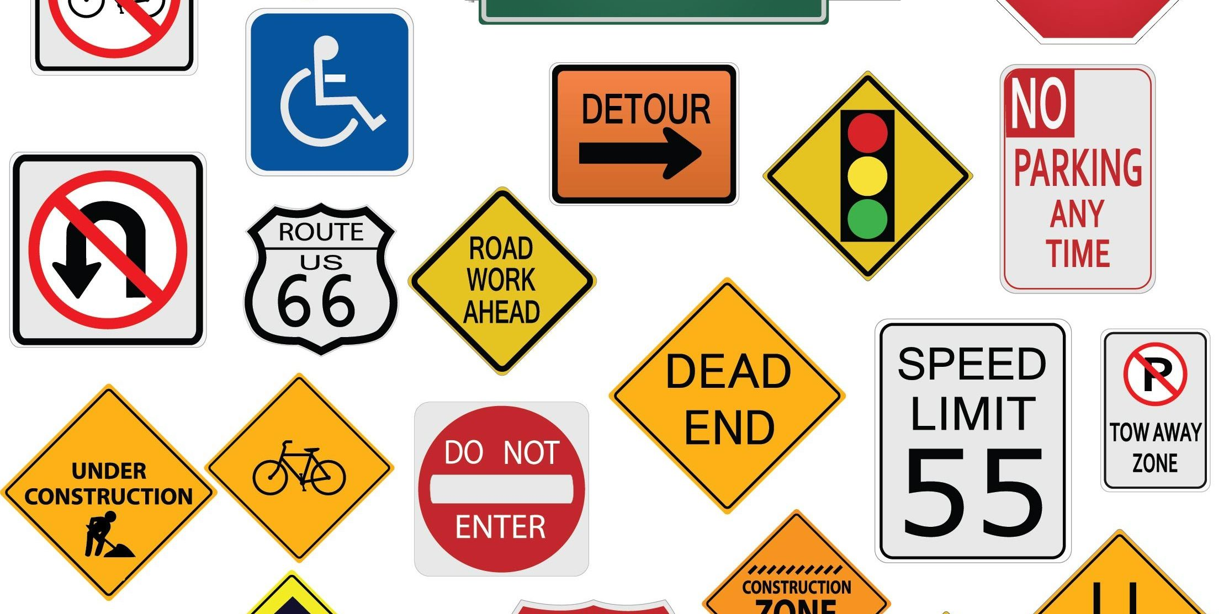
TRAFFIC SIGN RECOGNITION
[USING CNN]
Presented By:
Ch. Aasritha sai

Slide 2
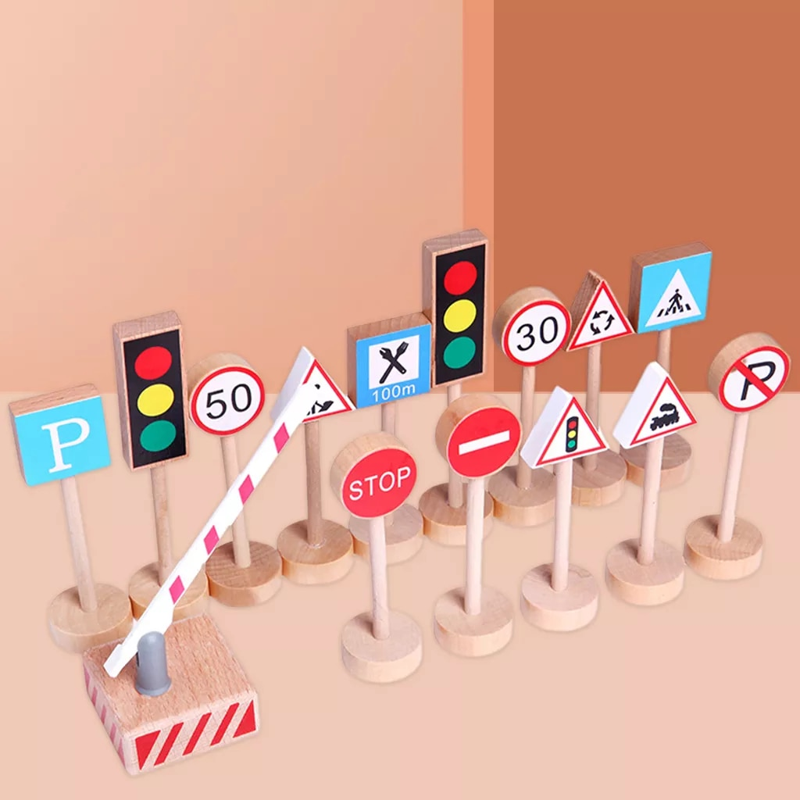
contents
INTRODUCTION
ADVANTAGES OF TRAFFIC SIGN RECOGNITION
CNN ARCHITECTURE
METHODOLOGY
PROJECT IMPLEMENTATION WITH DIAGRAM
DATASET
RESULT

Slide 3

INTRODUCTION
Traffic Signs Prediction received an increasing interest last year. This is due to the wide range of applications that a system with the capability provides, like the Driving Assistance System.
This is an attempt to make a self-learning system that can understand and interpret new traffic signs' meaning.
In this project, we will build a deep neural network model that can classify traffic signs present in the image into different categories. With this model, we can read and understand traffic signs which is a very important task for all autonomous vehicles.

Slide 4

advantages
Traffic sign recognition is an advanced driver assistance system that can recognize road signs and display the corresponding information in the vehicle. Traffic sign recognition is also known as traffic sign assist.
Traffic sign recognition uses a forward-facing video camera mounted in the area of the rearview mirror to permanently monitor road traffic signs.

Slide 5
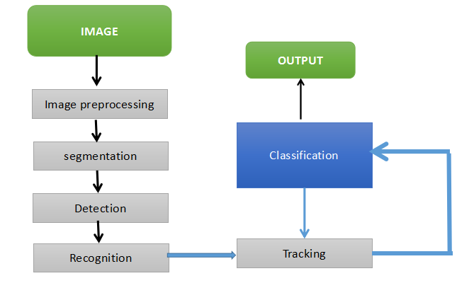
Cnn architecture

Slide 6

methodology
An improved Traffic Sign Prediction Algorithm for Intelligent Vehicles is proposed to address problems such as how easily affected Traditional Traffic signs predicted are by the environment and the poor real-time performance of deep learning-based methodologies for traffic sign recognition.
Firstly, Traffic sign recognition uses a forward-facing video camera mounted in the area of the rearview mirror to permanently monitor road traffic signs.
Secondly, if a traffic sign is recognized, this is tracked and displayed in the instrument panel or on the monitor of the navigation unit/infotainment system when the vehicle passes the sign.

Slide 7

Project implementation
Developing an efficient Machine Learning Model which would predict various Traffic Signs. This process is done in four steps:-
Gathering and exploring the dataset
Building a CNN Model
Training and testing the model
Deploying the model
This Photo by Unknown Author is licensed under CC BY-SA

Slide 8
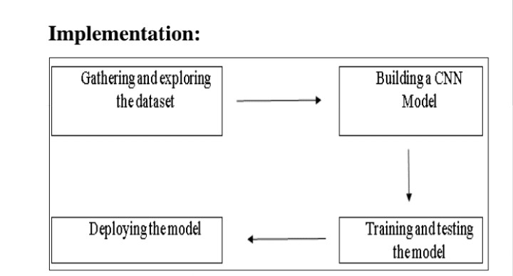
Diagrammatic representation

Slide 9
dataset
The dataset which we have used for this project is the German Traffic Signs Dataset.
Ref :
https://www.kaggle.com/datasets/meowmeowmeowmeowmeow/gtsrb-german-traffic-sign
We proposed a computerized method for the identification of traffic signs using a Convolution Neural Network.

Slide 10
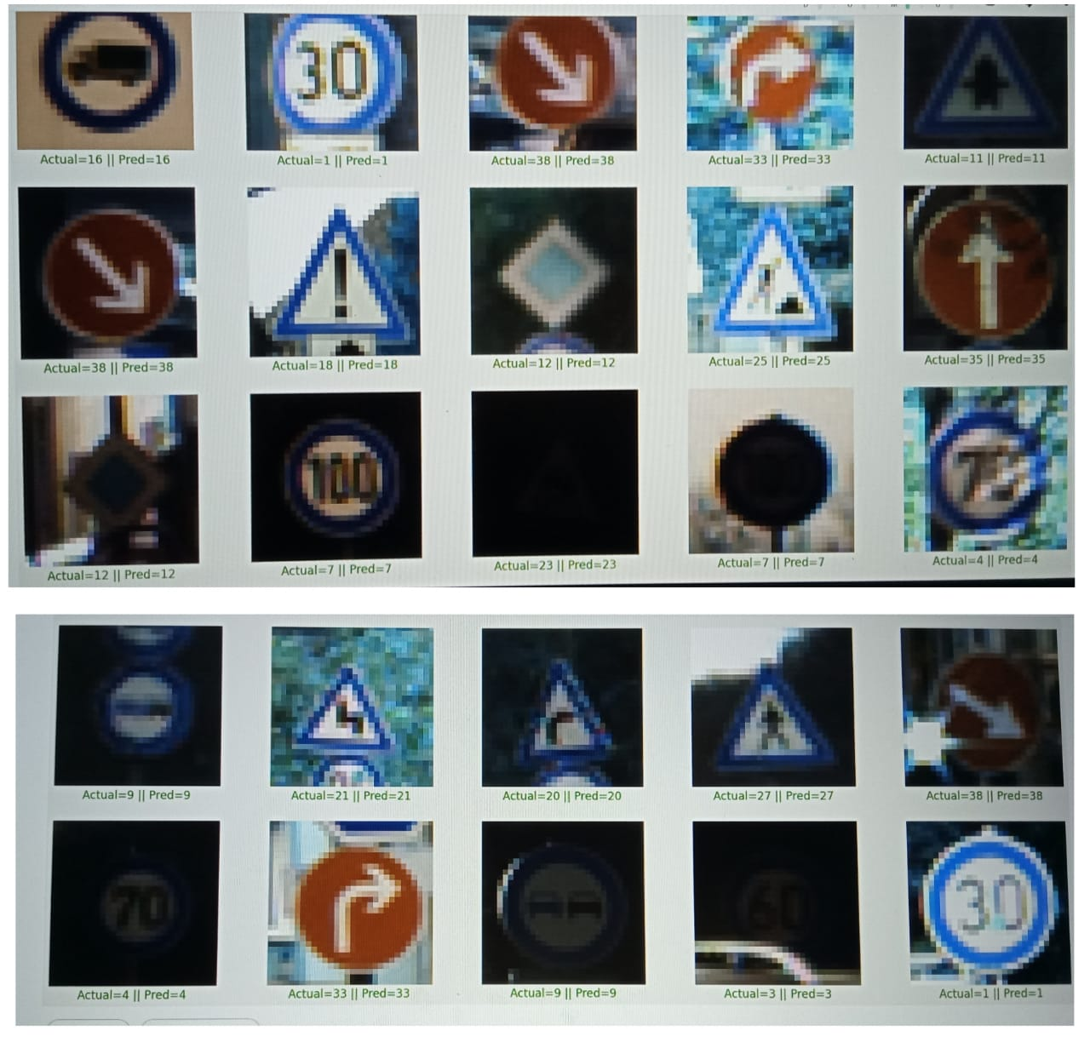
Result-predictions on test data

Slide 11


